Slide 1


P.E.S. College of Engineering, Mandya-571401
(An Autonomous Institute under Visvesvaraya Technological University, Belagavi)
Department of Information Science and Engineering
Project phase-02 presentation on
“AI-Driven Stress, Anxiety, and
Depression Detection and Lifestyle Support System”
Submitted By: Submitted To:
Disha T.S (4PS22IS019) Prof. Rashmi Y.S
M. Chakravarthy (4PS22IS031) Assistant Professor
Sanjana L (4PS22IS047) Dept. Of IS&E
Vaishak M.A (4PS22IS054) Pesce, Mandya.

Slide 2
Agenda
Introduction
Objectives Recap
Deliverables
Updated System Architecture
Model Completion Status
Next Steps

Slide 3
Introduction
This project aims to develop an AI-driven web platform that integrates healthcare (mental well-being) and lifestyle improvement.
The system uses sentiment analysis to understand users’ emotions through text inputs and provides personalized recommendations, daily wellness tips, and professional psychiatrist support.
It ensures a secure, user-friendly, and confidential environment to track emotional progress and promote healthier living habits.
The platform bridges the gap between mental health and lifestyle management. This intelligent platform represents a holistic approach to improving overall well-being using technology and empathy.

Slide 4
Recap of Objectives
To collect an emotion-labeled dataset and train a robust NLP model for emotion classification, forming the foundation for mental-health prediction. (Completed in Phase-2)
To implement advanced NLP and sentiment-analysis techniques to accurately identify user emotions and detect early signs of mental distress.
To provide personalized lifestyle and mental-wellness recommendations such as relaxation techniques, activity suggestions, and self-care routines based on the user’s emotional state.
To ensure strong user-data privacy, ethical AI usage, and secure handling of sensitive mental-health information.
To develop an interactive and user-friendly web interface that allows users to monitor mood trends and view personalized wellness insights.

Slide 5
Objective Completion Status (Phase-2)
Objective | Description | Status
Objective 1 | Collect an emotion-labeled dataset and train a robust NLP model for emotion classification. | Completed
Objective 2 | Implement NLP and sentiment-analysis techniques to identify user emotions and detect early signs of mental distress. | In Progress / Upcoming
Objective 3 | Achieve at least 80% accuracy in classifying stress, anxiety, and depression using ML/DL models. | Upcoming
Objective 4 | Provide personalized lifestyle and mental-wellness recommendations based on detected emotional states. | Upcoming
Objective 5 | Ensure user-data privacy, ethical AI usage, and secure handling of sensitive mental-health information. | Ongoing
Objective 6 | Develop an interactive, user-friendly web interface for mood tracking and personalized insights. | Upcoming

Slide 6
Deliverables
Dataset Preparation (GoEmotions – Google AI)
Loaded the GoEmotions dataset (58k+ labeled text samples) using load_dataset("go_emotions").
Used official splits: Train, Validation, Test.
Extracted 27 emotion labels + neutral for multi-label classification.
Preprocessing Pipeline (Implemented in Code)
Tokenized text using DistilBERT tokenizer (distilbert-base-uncased).
Applied truncation (max_length=512), padding, and text normalization.
Converted label lists into multi-hot vectors for multi-label learning.
Cast all labels to float32 for PyTorch compatibility.
Set final dataset format to PyTorch tensors: input_ids, attention_mask, labels.

Slide 7
Deliverables
Model Training Deliverable
Used AutoModelForSequenceClassification with 27 labels and multi-label classification.
Performed evaluation at each epoch and selected best model using F1-micro score.
Successfully trained model using HuggingFace Trainer API.
Evaluation Deliverable
Implemented Micro F1-score and Exact Match Accuracy as evaluation metrics.
Applied sigmoid activation with 0.5 threshold for multi-label predictions.
Evaluated final model on GoEmotions test split using custom metric function.

Slide 8
Deliverables
Emotion-to-Mental-State Mapping (Additional Deliverable)
Mapped GoEmotions labels into depression, anxiety, and stress indicator groups.
Built classifier to detect condition (stress / anxiety / depression / normal).
Implemented severity levels (mild / moderate / severe) based on probability scores.
Inference & Output Module
Implemented predict_emotions(text) to return emotion labels with probabilities.
Implemented classify_mental_state(text) to return mental-state category and severity.
Achieved complete end-to-end inference capability for real-time prediction.
Model Export Deliverable
Saved trained model to "distilbert-goemotions-mental".
Saved tokenizer for Phase-3 backend and web integration.

Slide 9
Updated System Architecture
Integrated GoEmotions dataset as the primary labelled emotion source.
Added complete preprocessing pipeline including tokenization, truncation, padding, and multi-hot encoding.
Incorporated DistilBERT-based multi-label emotion classification model trained on 27 emotion categories.
Implemented custom logic to map predicted emotions into mental-health categories: stress, anxiety, and depression.
Developed severity detection module using probability thresholds to classify mild, moderate, or severe levels.
Added inference module enabling real-time text processing and emotion prediction for future web integration.
Saved trained model and tokenizer for backend deployment in subsequent phases.

Slide 10
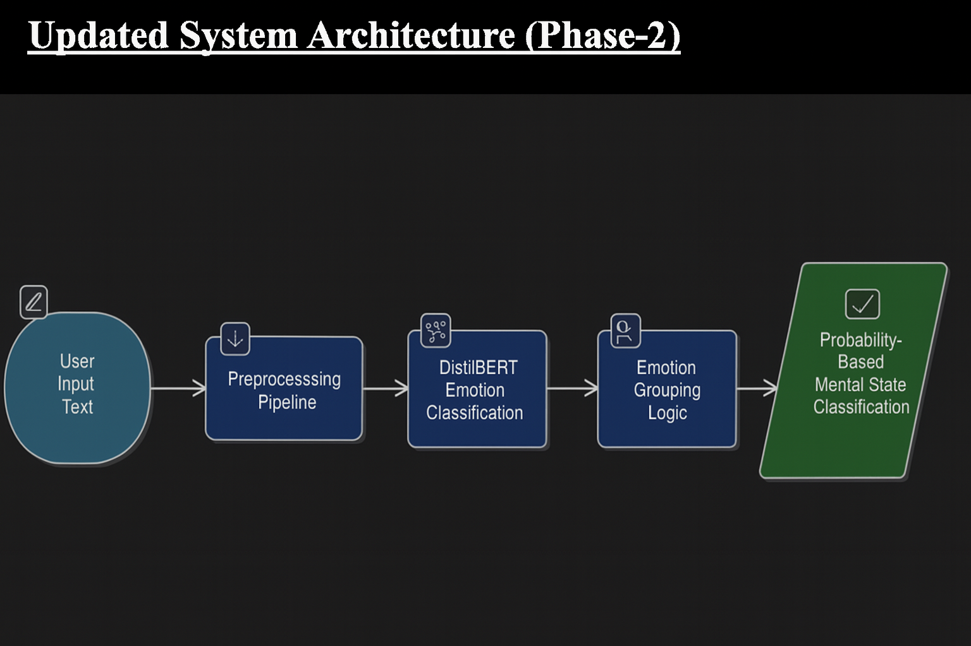

Slide 11
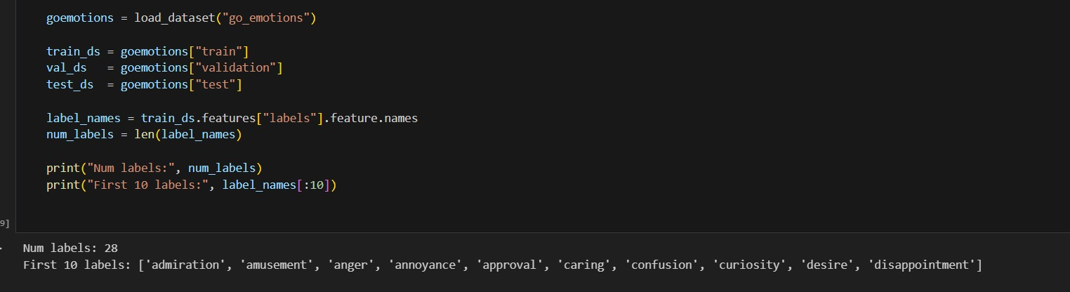
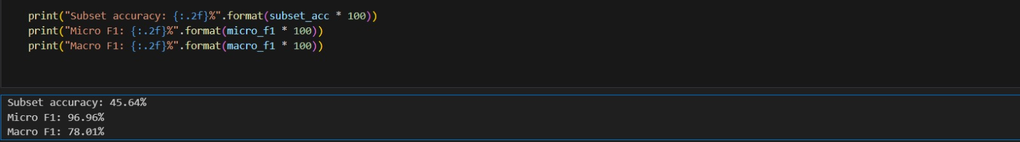
Code Snippets

Slide 12
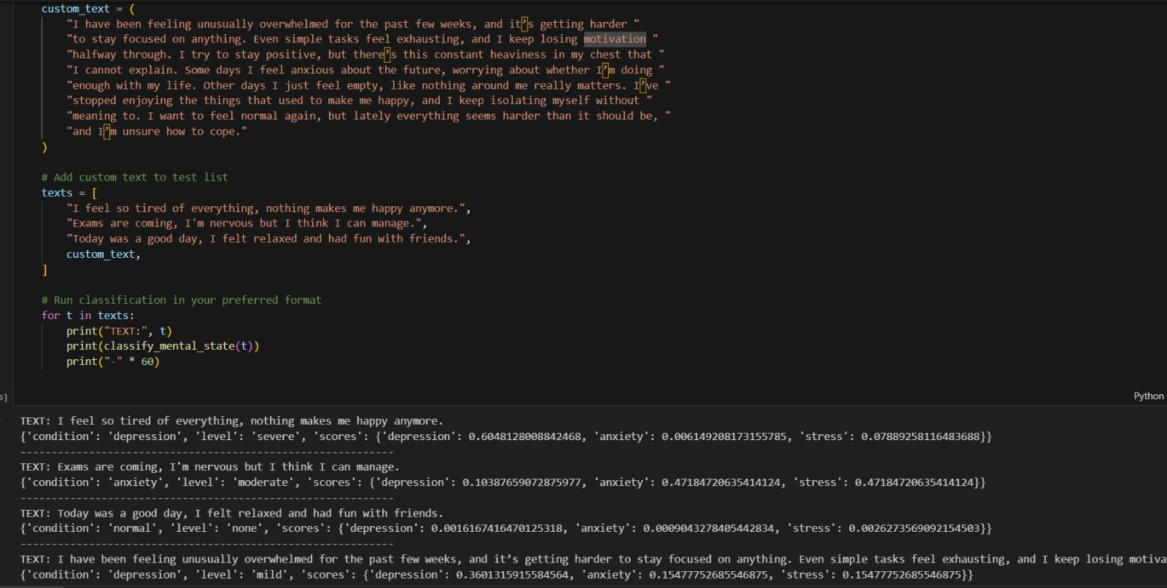
Code Snippets

Slide 13
Module Completion Status
Completed Modules
GoEmotions dataset loading and setup.
Dataset preprocessing pipeline including tokenization, truncation, padding, and multi-hot encoding.
Conversion of datasets into PyTorch-ready formats.
DistilBERT-based multi-label emotion classification model training.
Evaluation using micro F1-score and exact-match accuracy.
Emotion grouping into stress, anxiety, and depression categories.
Mental-state classification with severity detection logic.
Inference module for real-time emotion and mental-state prediction.
Export of trained model and tokenizer for Phase-3 integration.

Slide 14
Module Completion Status
In-Progress / Upcoming Modules
Full mental-health classifier refinement for improved accuracy.
Lifestyle recommendation engine development.
Web platform backend integration with trained model.
Dashboard and UI design for user interaction.
Secure data handling and privacy mechanisms.

Slide 15
Next Steps (Phase-3 Plan)
Improve Mental-Health Classification Accuracy
Refine emotion-to-mental-state mapping rules.
Explore ensemble models or fine-tuning with additional mental-health datasets.
Optimize thresholds and severity ranges for better prediction reliability.
Develop Lifestyle Recommendation Engine
Build rule-based and AI-driven recommendation logic.
Generate personalized wellness tips based on predicted stress, anxiety, and depression levels.
Integrate relaxation techniques, activity suggestions, and self-care routines.
Integrate Model with Web Backend
Deploy trained DistilBERT model as a REST API or microservice.
Implement secure endpoints for emotion and mental-state prediction.
Ensure scalability and response-time optimization.

Slide 16
Next Steps (Phase-3 Plan)
Create User Interface & Dashboard
Design an interactive and user-friendly web UI.
Enable users to input journal/text entries.
Visualize mood trends, emotional patterns, and prediction history.
Implement Secure Data Handling
Add encryption, anonymization, and ethical data-usage practices.
Ensure compliance with privacy requirements for sensitive emotional data.
End-to-End System Integration & Testing
Connect frontend, backend, and trained model.
Test complete user flow from text input → prediction → recommendations.
Conduct performance, usability, and reliability testing.

Slide 17
Thank You!

